Slide 1
Sociology: 3549 Normal distribution
Recitation #5
Yue Chu

Slide 2
announcement
Homework #2 has been distributed.
Homework 2 is due Oct. 23.
A few things about the homework.
Make sure you read the question carefully (e.g. sample vs population)
Make sure you answer ALL parts of question.

Slide 3
agenda
Review of lecture
Activity
Normal curve probabilities
In class exercise question
Type your answer to Carmen for attendance
Stata

Slide 4
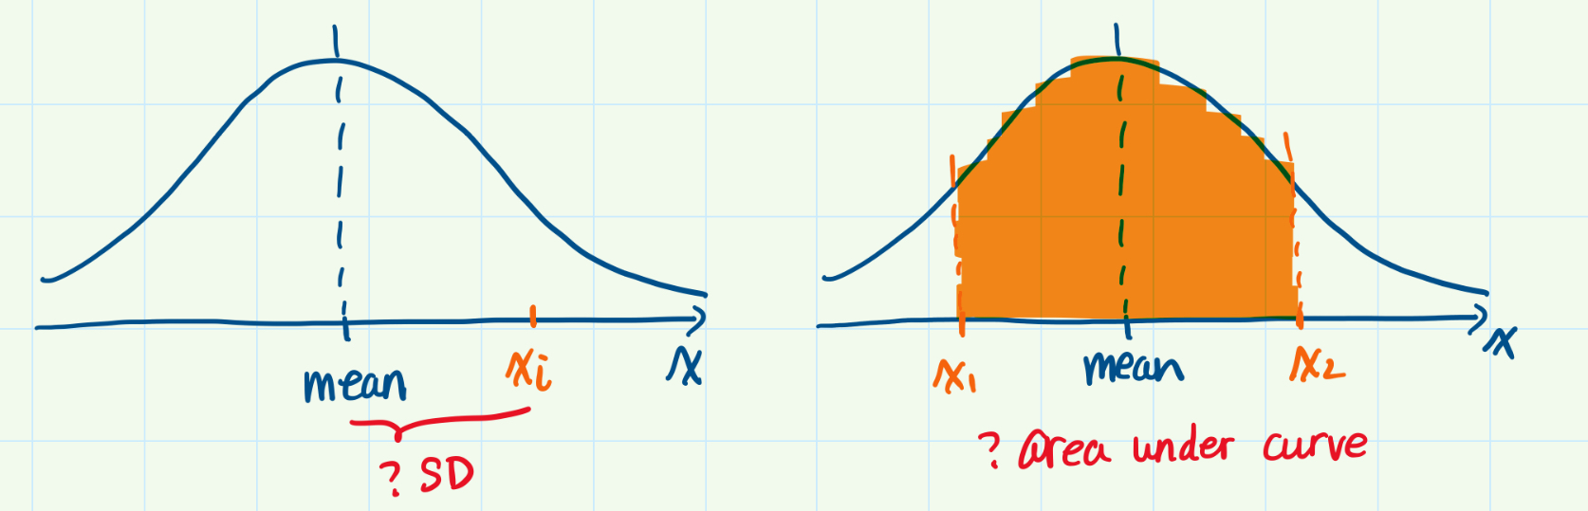

Z-score and probabilities
Test score example
Final exam: mean =70, SD = 7.5
Last week: if one student had 80, how well he has done relative to others?
Calculate z-score: $Z_{i}=\frac{X_{i}−μ}{σ}$
This week: % students scored 70-80 in class?
Calculate the areas under the normal curve

Slide 5
important properties of normal curve
Uni-modal, bell-shaped curve
Continuous distribution
Symmetric
Mean = Median
Standard normal curve (Mean=0, SD=1)
Area under the normal curve represents probability that a variable is within a range in the normal distribution
Area under the normal curve equal one
Notes:
Z-score: number of SD, a particular value is from the mean

Slide 6
calculation
Discrete variable
Frequency distributions
Continuous variable, or no detailed info
Math: integral calculus
Use the normal curve table
Also called z-score table
Score | Relative proportion
… | …
70 | 0.10
71 | 0.08
… | …
79 | 0.05
80 | 0.04
81 | 0.03
… | …
Total | 1.00

Slide 7
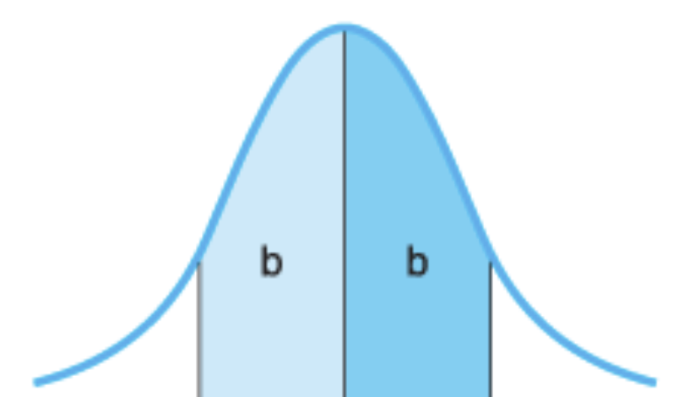
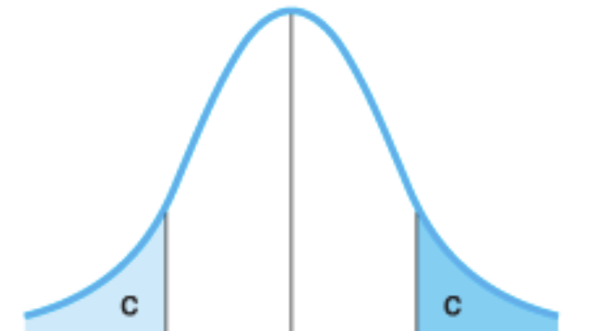
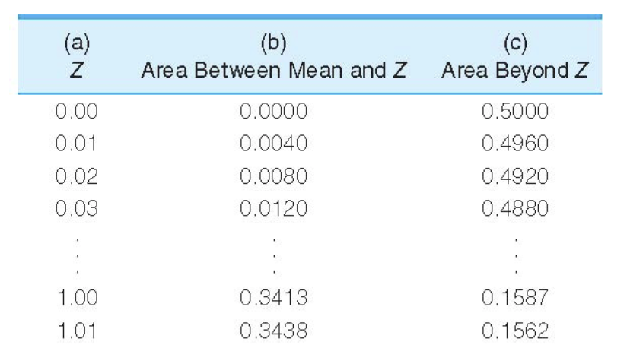
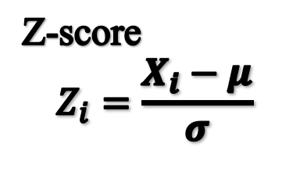
The normal curve table
Z-score
$$Z_{i}=\frac{X_{i}−μ}{σ}$$

Slide 8
The normal curve table
Z-score
$$Z_{i}=\frac{X_{i}−μ}{σ}$$
0.50

Slide 9
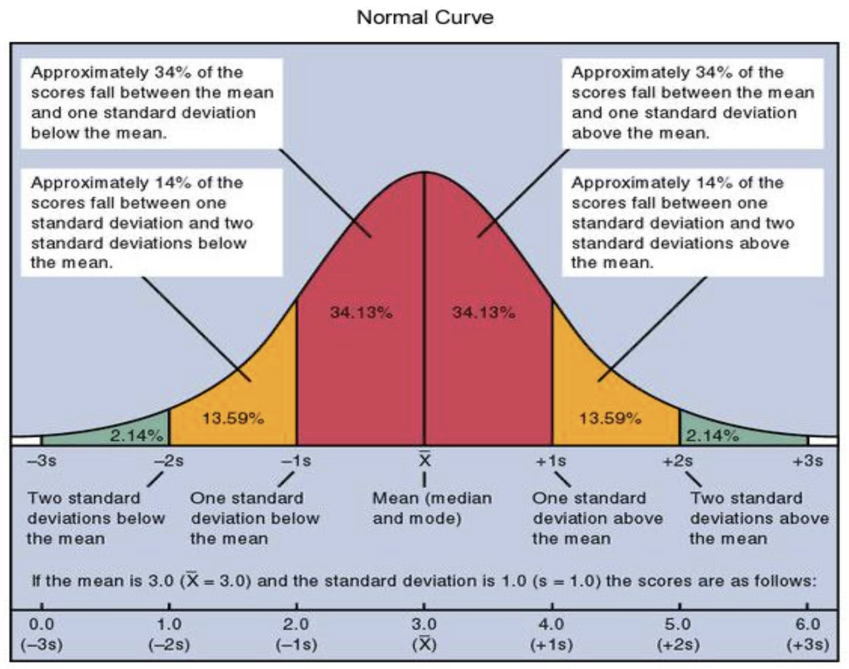
68-95-99 RULE
Areas under normal curve
About 68.2% of scores are within ±1 SD from mean.
About 95.5% of scores are within ± 2 SD from mean.
About 99.7% of scores are within ±3 SD from mean.

Slide 10
Step by step calculation
convert
Convert raw score to z score
draw
Identify the area of interest in the standard normal curve
find
Find absolute value of your z score in Appendix A – column A
Calculate
Calculate and interpret

Slide 11
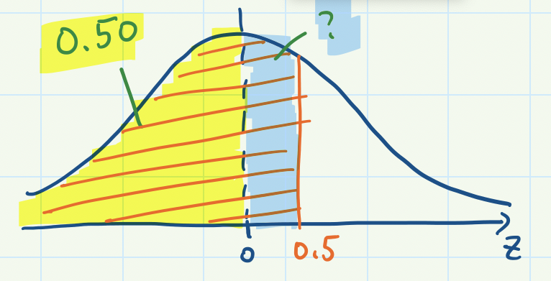
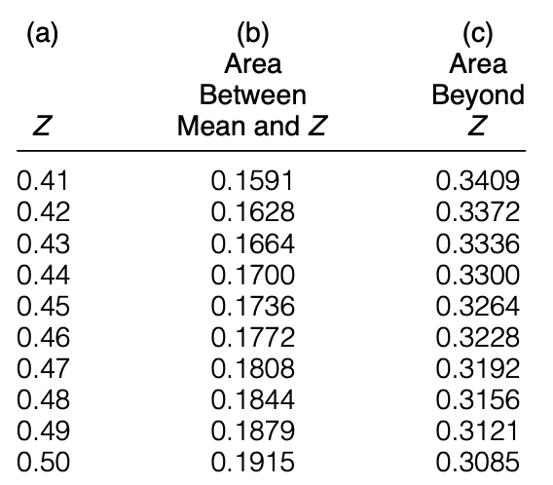

Example #1 – one positive z score
Birth weights of girl in US have mean = 3.23 kg, SD = 0.14 kg
Question 1: what is the percentage of girls with birth weight less than 3.3kg?
Convert
Draw
Find
Calculate
Z-score
0.50+0.1915 =0.6915
Interpretation:
69.15% of girls has birth weight less than 3.3 kg.
$$z=\frac{x_{i}−\overline{x}}{s}=\frac{3.3−3.23}{0.14}=0.50$$

Slide 12
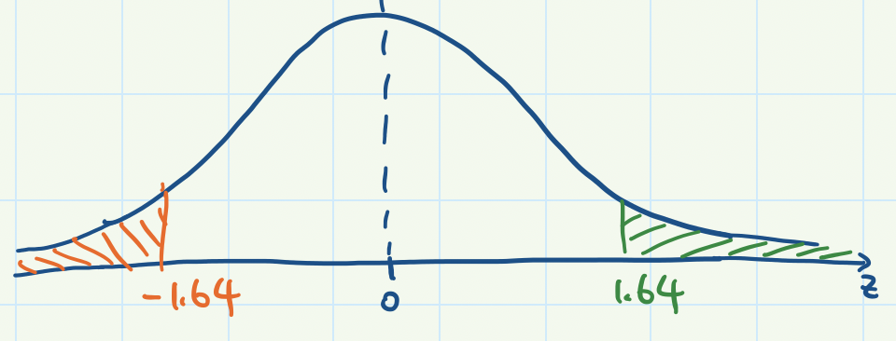
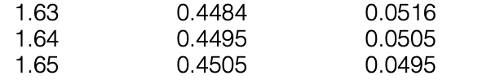

Example #2 – one negative z score
Birth weights of girl in US have mean = 3.23 kg, SD = 0.14 kg
Question 2: what is the percentage of girls with birth weight less than 3.0 kg?
Convert
Draw
Find
Calculate
Z-score
$$z=\frac{x_{i}−\overline{x}}{s}=\frac{3.0−3.23}{0.14}=−1.64$$
Interpretation: 5.05% of girls has birth weight less than 3.0 kg.

Slide 13
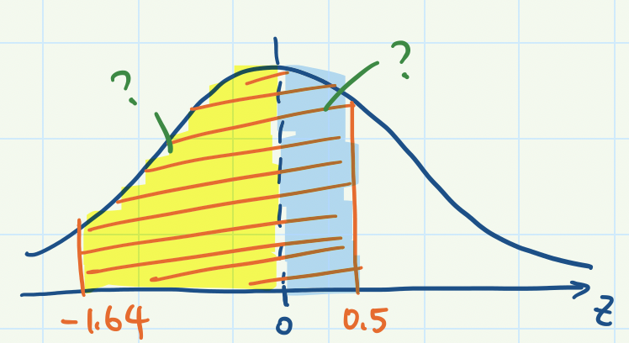

Example #3 – range covering mean
Birth weights of girl in US have mean = 3.23 kg, SD = 0.14 kg
Question 3: what is the probability of a randomly selected girl having birth weight between 3.0 and 3.3 kg?
Convert
Draw
Find
Calculate
Z-score
0.4495+0.1915=0.641
Interpretation:
The probability of a randomly selected girl in US having birth weight between 3 and 3.3 kg is 0.641 or 64.1%.
$$z_{1}=−1.64$$
$$z_{2}=0.50$$

Slide 14
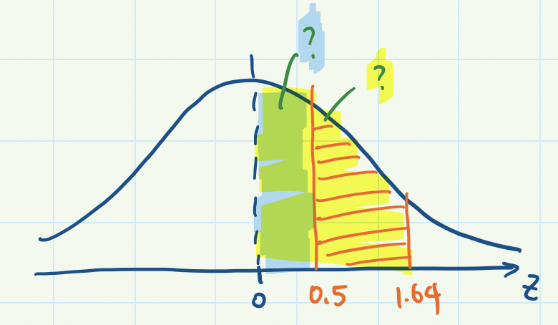


Example #4 – range not covering mean
Birth weights of girl in US have mean = 3.23 kg, SD = 0.14 kg
Question 3: what is the probability of a randomly selected girl having birth weight between 3.3 and 3.46 kg?
Convert
Draw
Find
Calculate
Z-score
0.4495-0.1915=0.258
Interpretation:
The probability of a randomly selected girl in US having birth weight between 3.3 and 3.46 kg is 0.258 or 25.8%.
$$z_{1}=0.50$$
$$z_{2}=1.64$$

Slide 15
Interpretation of area under normal curve
Estimating percentage of observations within a range in the normal distribution
Example of interpretation: 64.1% of girls in US has birth weight between 3 and 3.3kg.
Predicting the probability of a random observation taking on a range of values in the normal distribution
Example of interpretation: The probability of a randomly selected girl in US having birth weight between 3 and 3.3 kg is 0.641 or 64.1%.
Notes:
Z-score: number of SD, a particular value is from the mean

Slide 16
In-class exercise
Test score example
Final exam: Mean = 70, SD = 7.5
Questions:
The percentage of students with score above 80?
The percentage of students with score 60-77?
Type your answer in Carmen Assignment – Lab attendance Oct.5

Slide 17
Now let’s do this in Stata.

